Slide 1
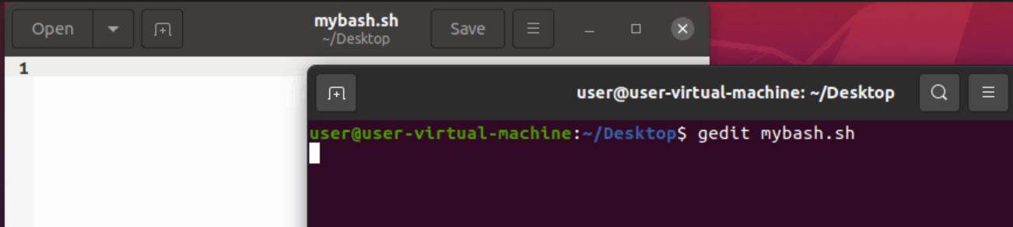
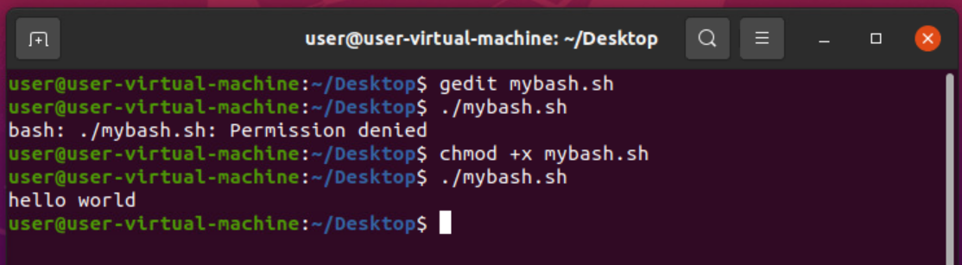
Shell Scripting
1) gedit filename.sh :- Used to create file with shell extension.
2) chmod +x filename.sh :- Used to give permission to execute the shell file.
3) ./filename.sh :- Used to execute the file.

Slide 2
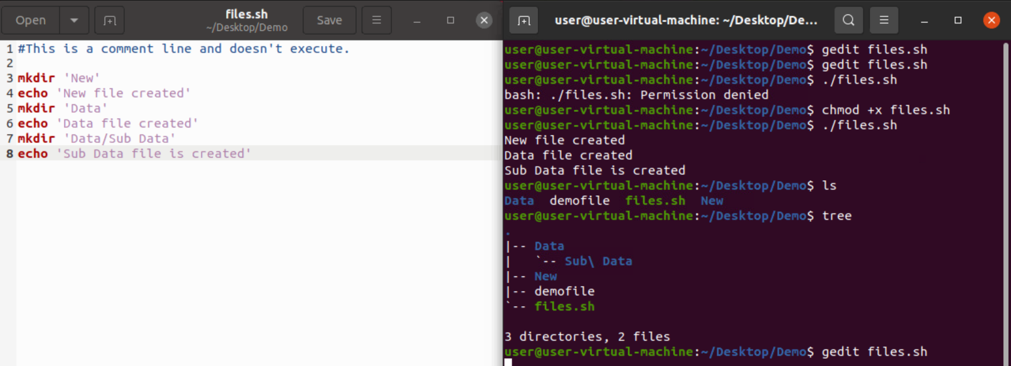
4) We can use commands inside shell file and give permission. Then it will execute all commands present inside shell file.

Slide 3
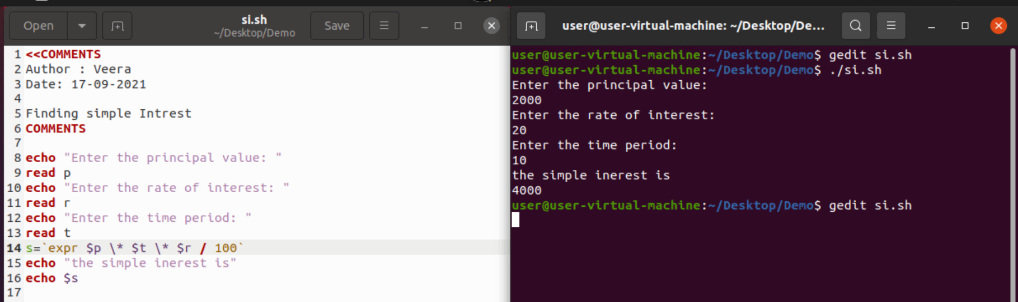
5) WAP for finding Simple interest .

Slide 4
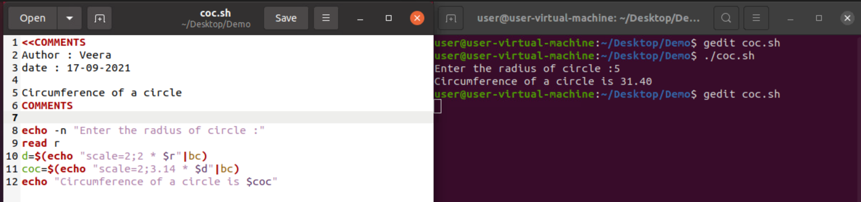
6) WAP for Circumference of a circle :-

Slide 5
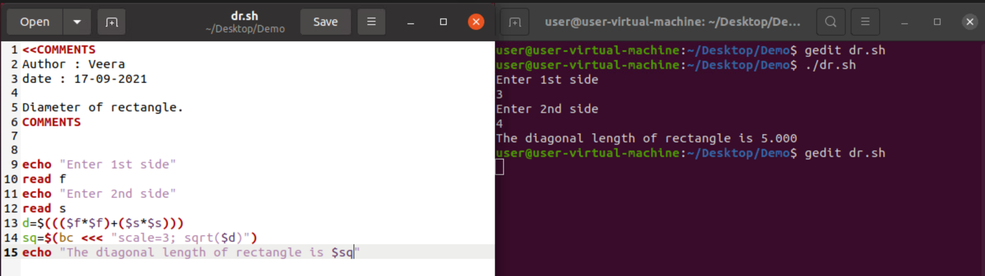
7) WAP for Diagonal of Rectangle :--

